Slide 1

EDA: GRAPHICAL TECHNIQUES DATA SCIENCE -18CS3211 Session no: 06

Slide 2

AGENDA FOR THE CLASS
Introduction
Basic graphs for EDA: Histogram and Scatterplot
Shape base EDA: Skewness and Kurtosis
Choosing the Best Chart
Different graphical techniques and their purpose
Summary

Slide 3
INTRODUCTION
As data scientists, two important goals in our work would be to extract knowledge from the data and to present the data to stakeholders.
Presenting results to stakeholders is very complex in the sense that our audience may not have enough technical know-how to understand programming jargon and other technicalities.
Hence, visual aids are very useful tools.
In this class we are going to learn about different types of techniques that can be used in the visualization of data.

Slide 4
Shape base EDA: Skewness
The literal meaning of “skew” is a bias, dragging, or distortion toward some particular value, group, subjects, or direction.
A measure of skewness is a numeric metric to concisely summarize the degree of asymmetry of a unimodal distribution that can be compared with other similar numbers.
Skewness is a measure of symmetry, or more precisely, the lack of symmetry. A distribution, or data set, is symmetric if it looks the same to the left and right of the center point.

Slide 5
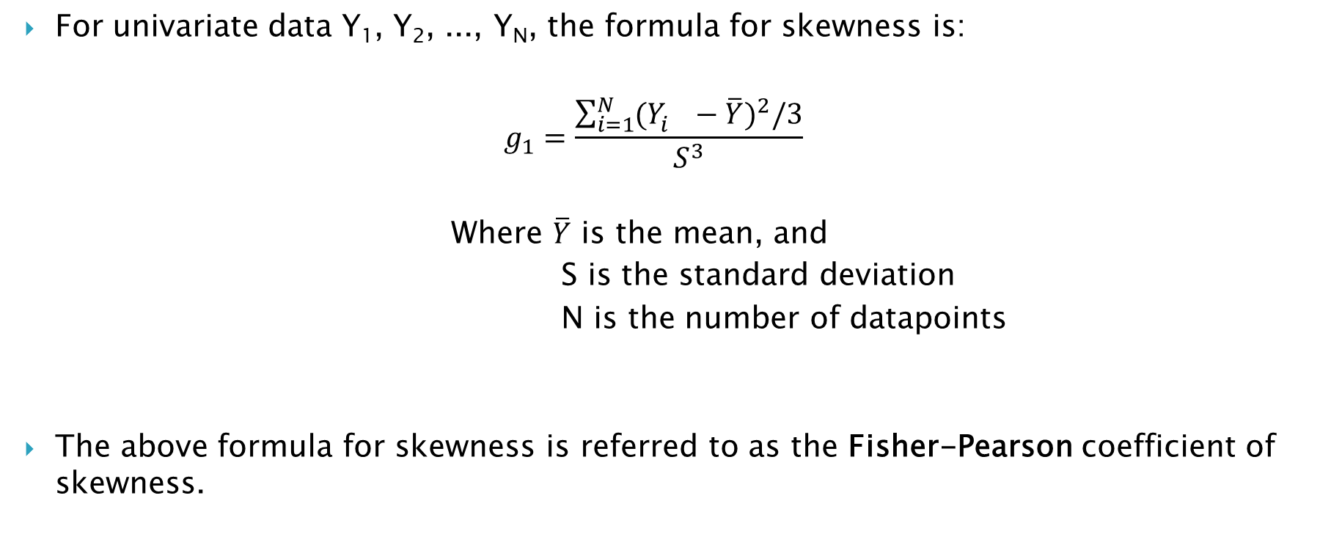
Calculating Skewness
For univariate data Y₁, Y₂, ..., Y_{N}, the formula for skewness is:
$$g_{1}=\frac{\sum_{i=1}^{N}{{(Y_{i}^{}−\overline{Y})}^{2}/3}}{S^{3}}$$
Where $\overline{Y}$ is the mean, and
S is the standard deviation
N is the number of datapoints
The above formula for skewness is referred to as the Fisher-Pearson coefficient of skewness.

Slide 6
Types of Skewness
Mean
Mode
Mean
Median
Mode
Mode
Mean
Median
Median
Negatively
Skewed
Symmetric
(Not Skewed)
Positively
Skewed

Slide 7
When is the skewness too much?
The rule of thumb seems to be:
If the skewness is between -0.5 and 0.5, the data are fairly symmetrical.
If the skewness is between -1 and -0.5(negatively skewed) or between 0.5 and 1(positively skewed), the data are moderately skewed.
If the skewness is less than -1(negatively skewed) or greater than 1(positively skewed), the data are highly skewed.

Slide 8
Shape base EDA: Skewness
Kurtosis is a statistical measure that defines how heavily the tails of a distribution differ from the tails of a normal distribution.
In other words, kurtosis identifies whether the tails of a given distribution contain extreme values.
Along with skewness, kurtosis is an important descriptive statistic of data distribution.
Skewness essentially measures the symmetry of the distribution, while kurtosis determines the heaviness of the distribution tails.

Slide 9
Excess Kurtosis
An excess kurtosis is a metric that compares the kurtosis of a distribution against the kurtosis of a normal distribution.
The kurtosis of a normal distribution equals 3.
Therefore, the excess kurtosis is found using the formula below:
Excess Kurtosis = Kurtosis – 3

Slide 10
Types of Kurtosis
The types of kurtosis are determined by the excess kurtosis of a particular distribution.
The excess kurtosis can take positive or negative values, as well as values close to zero.
Depending on the value of excess kurtosis, there three types of kurtosis:
Mesokurtic
Leptokurtic
Platykurtic

Slide 11
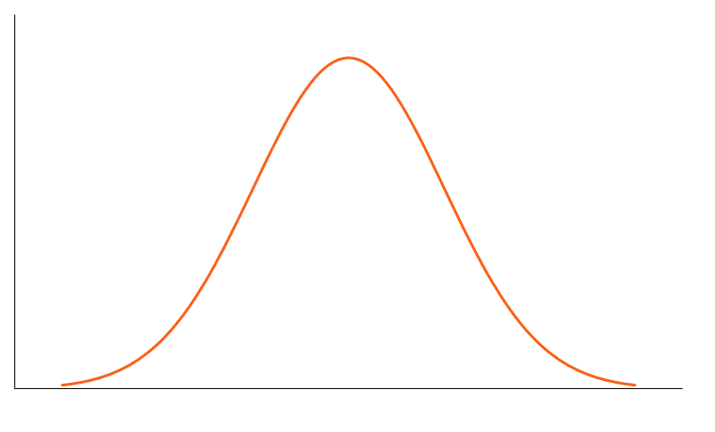
MESOKURTIC
Data that follows a mesokurtic distribution shows an excess kurtosis of zero or close to zero.
This means that if the data follows a normal distribution, it follows a mesokurtic distribution.

Slide 12
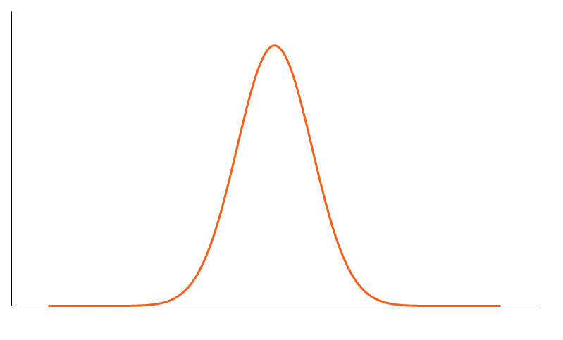
LEPTOKURTIC
Leptokurtic indicates a positive excess kurtosis.
The leptokurtic distribution shows heavy tails on either side, indicating large outliers.

Slide 13
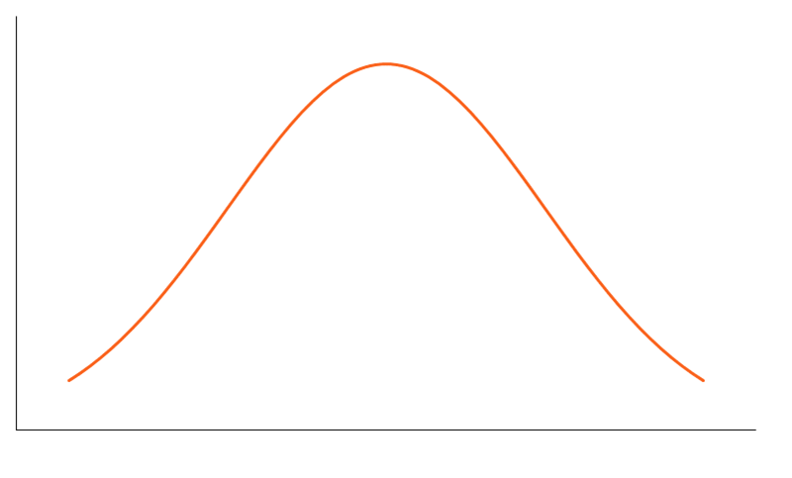
PLATYKURTIC
A platykurtic distribution shows a negative excess kurtosis.
The kurtosis reveals a distribution with flat tails.
The flat tails indicate the small outliers in a distribution.

Slide 14
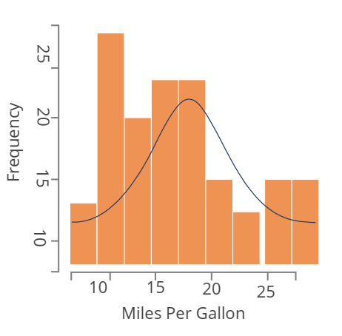
HISTOGRAMS
Histogram graphically summarizes the distribution of a univariate dataset. It shows: • the center or location of data (mean, median, or mode) • the spread of data • the skewness of data • the presence of outliers • the presence of multiple modes in the data

Slide 15
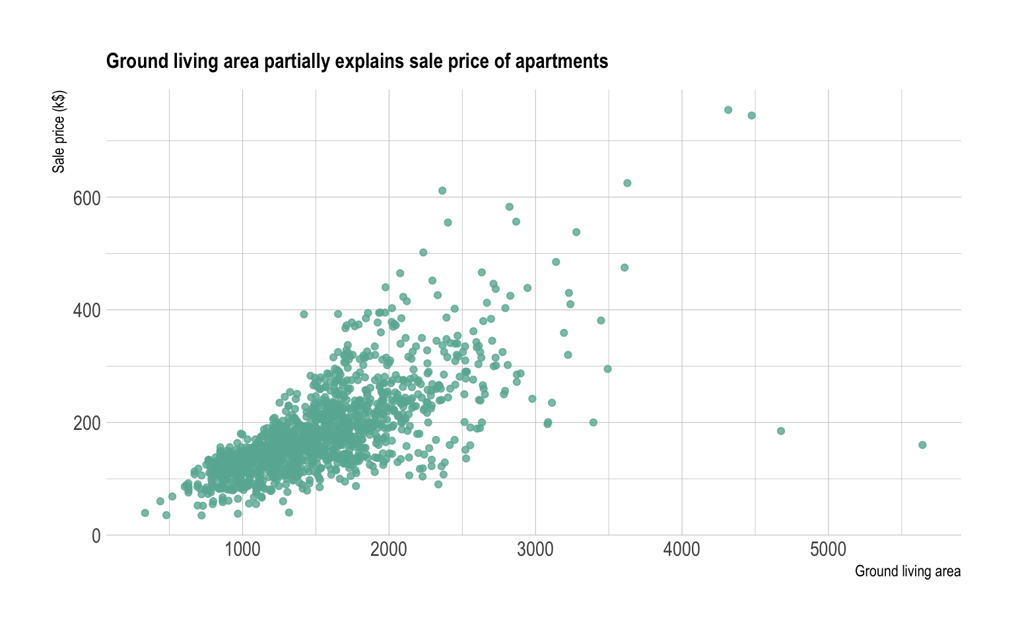
SCATTER PLOTS
A Scatter plot represents relationships between two variables. It can answer these questions visually:
Are variables X and Y related?
Are variables X and Y linearly related?
Are variables X and Y non-linearly related?
Does change in variation of Y depend on X?
Are there outliers?

Slide 16
CHOOSING THE BEST CHART
There is no standard that defines which chart you should choose to visualize your data.
However, there are some guidelines that can help you. Here are some of them:
As mentioned with each of the preceding charts that we have seen, it is important to understand what type of data you have. If you have continuous variables, then a histogram would be a good choice. Similarly, if you want to show ranking, an ordered bar chart would be a good choice.

Slide 17
CHOOSING THE BEST CHART
Choose the chart that effectively conveys the right and relevant meaning of the data without actually distorting the facts.
Simplicity is best. It is considered better to draw a simple chart that is comprehensible than to draw sophisticated ones that require several reports and texts in order to understand them.
Choose a diagram that does not overload the audience with information. Our purpose should be to illustrate abstract information in a clear way

Slide 18
CHOOSING THE BEST CHART
Having said that, let's see if we can generalize some categories of charts based on various purposes.
The following slides shall depict different types of charts based on the purposes:

Slide 19
PURPOSE: SHOW CORRELATION
Scatter plot
Correlogram
Pairwise plot
Jittering with strip plot
Counts plot
Marginal histogram
Scatter plot with a line of best fit
Bubble plot with circling

Slide 20
PURPOSE: SHOW DEVIATION
Area chart
Diverging bars
Diverging texts
Diverging dot plot
Diverging lollipop plot with markers

Slide 21
PURPOSE: SHOW DISTRIBUTION
Histogram for continuous variable
Histogram for categorical variable
Density plot
Categorical plots
Density curves with histogram
Population pyramid
Violin plot
Joy plot
Distributed dot plot
Box plot

Slide 22
PURPOSE: SHOW COMPOSITION
Waffle chart
Pie chart
Treemap
Bar chart

Slide 23
PURPOSE: SHOW CHANGE
Time series plot
Time series with peaks and troughs annotated
Autocorrelation plot
Cross-correlation plot
Multiple time series
Plotting with different scales using the secondary y axis
Stacked area chart
Seasonal plot
Calendar heat map
Area chart unstacked

Slide 24
PURPOSE: SHOW GROUPS
Dendrogram
Cluster plot
Andrews curve
Parallel coordinates

Slide 25
PURPOSE: SHOW RANKING
Ordered bar chart
Lollipop chart
Dot plot
Slope plot
Dumbbell plot

Slide 26
SUMMARY
Portraying any data, events, concepts, information, processes, or methods graphically has been always perceived with a high degree of comprehension on one hand and is easily marketable on the other.
Presenting results to stakeholders is very complex in the sense that our audience may not be technical enough to understand programming jargon and technicalities.
Hence, visual aids are widely used.

Slide 27


